Slide 1
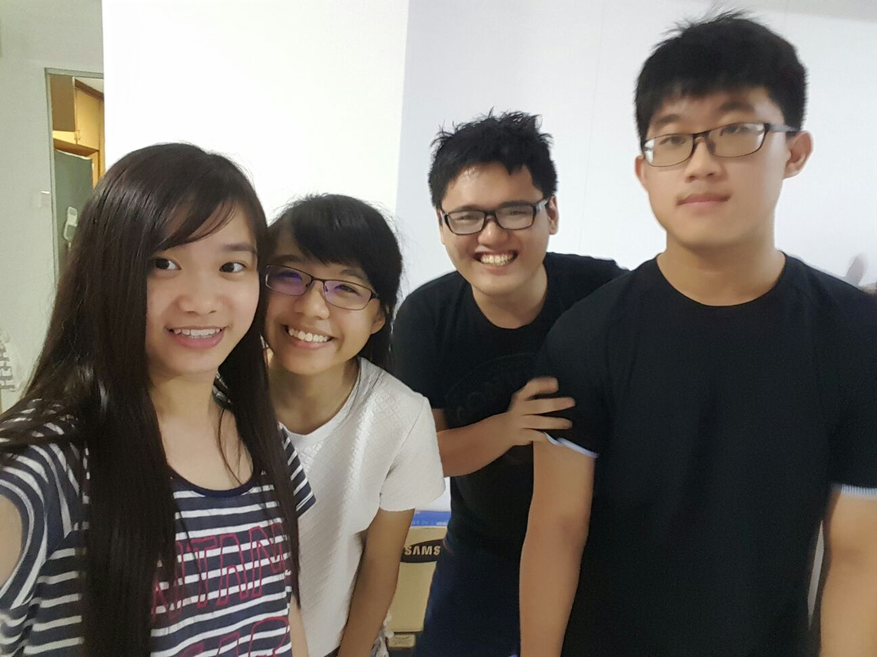
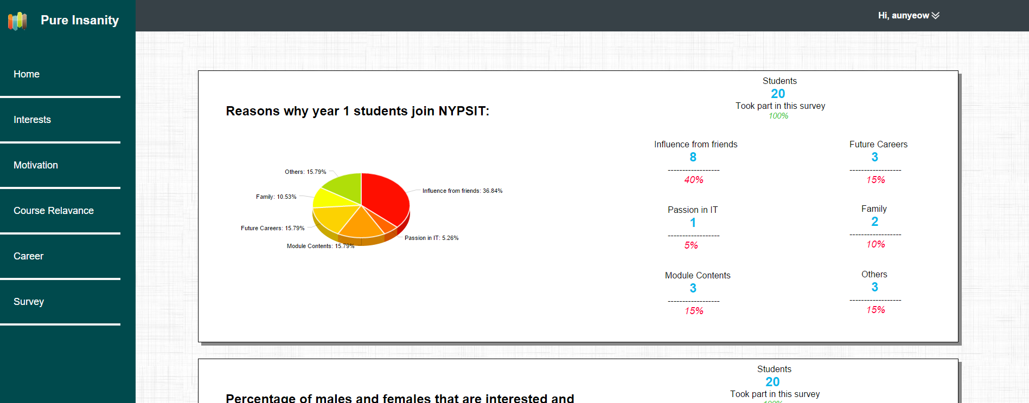
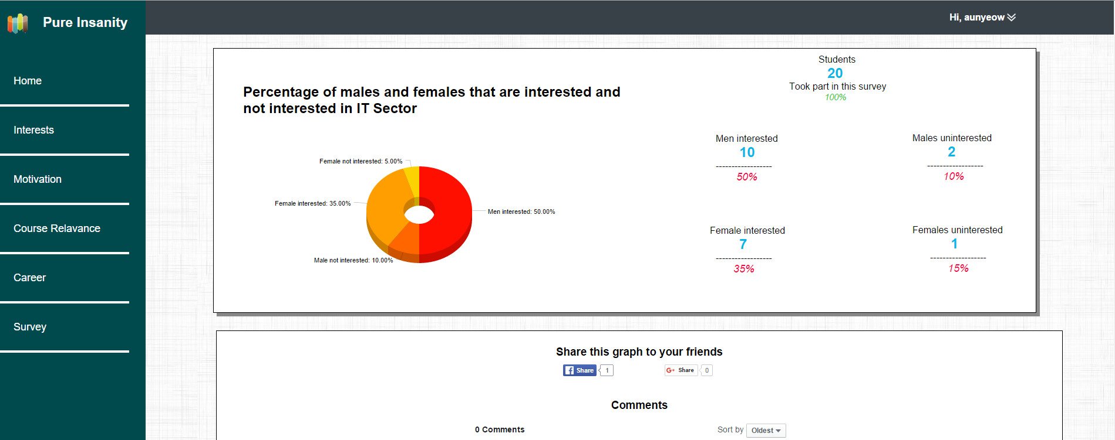
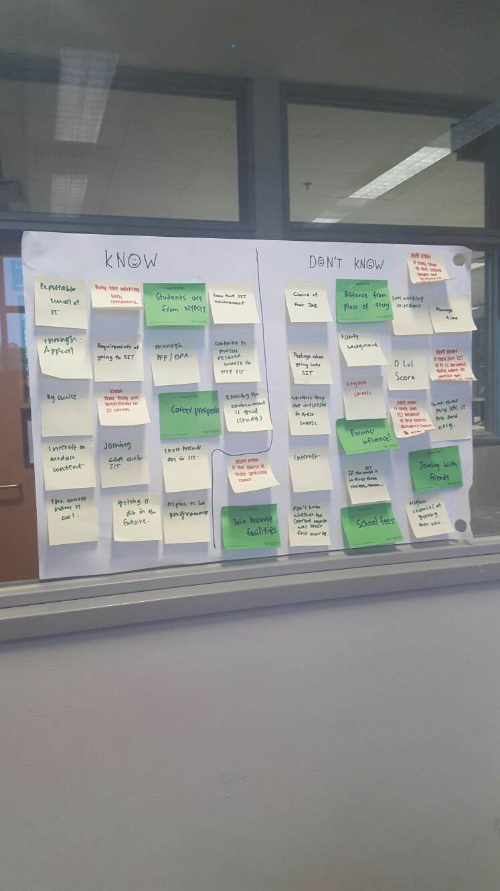
The Team
Aw Aun Yeow (152899E)
Tan Jun Long (151176T)
Chong Yan Qing (154466H)
Gan Wan Tian Mabel (151477X)
The Idea
This dashboard shows 2 graphs which describes the percentage of students that might be affected by the various reasons that caused them to join NYPSIT, as well as the percentages of students from each gender group that are interested in working in the IT sector. The graph data is presented such that users will be able to view the data easily.
How were the ideas generated
Design thinking enables us to narrow down the suitable questions to ask the target audience, in this case the target audience is NYPSIT students, in order to get closer to achieving the challenge question. The ideas were mostly generated based on the survey questions that my group and I came up with. Moreover, My group and I have decided to design the UI similarly to material design.

